Slide 1
P. Sci.
Unit 3
Work, Power, and Machines
SPS8: Students will determine relationships among force, mass, and motion.
SPS8.e: Calculate amounts of work and mechanical advantage using simple machines.

Slide 2
Work
When a force causes an object to move – work is done.

Slide 3
Work cont.
Work = Force x distance
Or
W = F x d

Slide 4
If the object does not move then no work is done.
W = F x d
If d = 0
any number times 0 is 0
so no work.

Slide 5
Work also depends on direction.
The force has to be in the same direction as the motion or no work is done on the object.
Lifting the Books
Carrying the Books
Force
Force
& Motion
The same
& Motion
perpendicular
Work is Not Done
Work is done

Slide 6
The SI unit for work is joules (J)
F = N= kg m/s² d = m
So
W = F x d = Nm
1 J = 1kg x m²/s² = 1 Nm

Slide 7
Work or Not?
Carrying a box across the ramp
a mouse pushing a piece of cheese with its nose across the floor

Slide 8
What’s work?
A scientist delivers a speech to an audience of his peers.
A body builder lifts 350 pounds above his head.
A mother carries her baby from room to room.
A father pushes a baby in a carriage.
A woman carries a 20 kg grocery bag to her car?

Slide 9
What’s work?
A scientist delivers a speech to an audience of his peers. No
A body builder lifts 350 pounds above his head. Yes
A mother carries her baby from room to room. No
A father pushes a baby in a carriage. Yes
A woman carries a 20 km grocery bag to her car? No

Slide 10
Work
Work is the
  transfer of energy through motion
  force exerted through a distance
W = Fd
W: work (J)
F: force (N)
d: distance (m)
1 J = 1kg x m²/s² = 1 Nm
Distance must be in direction of force!

Slide 11
Work
Brett’s backpack weighs 30 N. How much work is done on the backpack when he lifts it 1.5 m from the floor to his back?
GIVEN:
F = 30 N
d = 1.5 m
W = ?
WORK:
W = F·d
W = (30 N)(1.5 m)
W = 45 J
W
F
d

Slide 12
Work
If it takes 375 J of work to push a box 75 m what is the force used to push the box?
GIVEN:
d = 75 m
W = 375 J or 375 Nm
F = ?
WORK:
F = W/d
F =(375 Nm)/(75m)
F = 5.0 N
W
F
d

Slide 13
Work
A dancer lifts a 40 kg ballerina 1.4 m in the air and walks forward 2.2 m. How much work is done on the ballerina during and after the lift?
GIVEN:
m = 40 kg
d = 1.4 m - during
d = 2.2 m - after
W = ?
WORK:
W = F·d F = m·a
F =(40kg)(9.8m/s²)=392 N
W = (392 N)(1.4 m)
W = 549 J during lift
No work after lift. “d” is not in the direction of the force.
W
F
d

Slide 14
Power
The rate at which work is done
Remember that a rate is something that occurs over time

Slide 15
work
Power = time
Or
W
P = t
The SI unit for Power is watts (W)

Slide 16
A watt is the amount of power required to do
1 J of work in 1 s
So
P= W/t
P= J/s
Watts = J/s

Slide 17
Power
How much power is used to do 375 J of work in 15 seconds?
GIVEN:
P = ?
W = 375 J
t = 15 s
WORK:
P = W/t
P = 375 J/ 15 s
P = 25 J/s or 25 W
W
P
t

Slide 18
Power
If 25 W of power is used to do 450 J of work how long did it take to do the work?
GIVEN:
P = 25 W or 25 J/s
W = 450 J
t = ?
WORK:
t = W/P
t = (450 J) /(25 J/s)
t = 18 s
W
P
t

Slide 19
Making Work Easier
The Simple Machines
  Lever
  Pulley
  Wheel & Axle
  Inclined Plane
  Screw
  Wedge

Slide 20
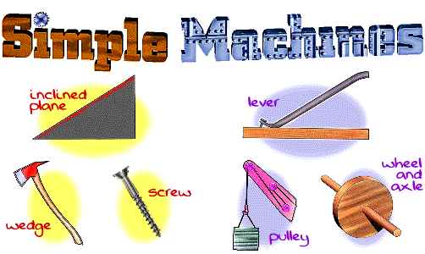

Slide 21

Machine – a device that makes doing work easier by…

Slide 22
increasing the force that can be applied to an object. (car jack)

Slide 23
increasing the distance over which the force can be applied. (ramp)

Slide 24
by changing the direction of the applied force. (opening the blinds)

Slide 25
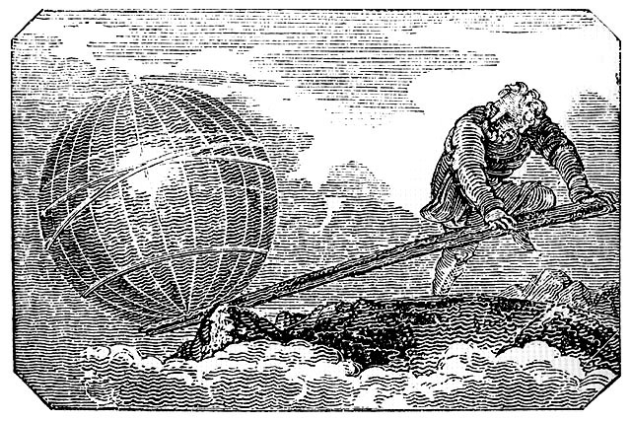
A. Lever
Lever
  a bar that is free to pivot about a fixed point, or fulcrum
Effort arm
You apply your force
Resistance
Arm
Work is done here.
Fulcrum
Engraving from Mechanics Magazine, London, 1824
“Give me a place to stand and I will move the Earth.”
– Archimedes

Slide 26
A. Lever
Ideal Mechanical Advantage (IMA)
  frictionless machine
Effort arm length
Resistance
arm length
  L_{e} must be greater than L_{r} in order to multiply the force.

Slide 27
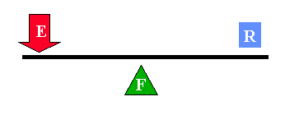

First Class Lever
First Class Lever
  the fulcrum is in the middle
  changes direction of force
  Ex: hammer, seesaw

Slide 28
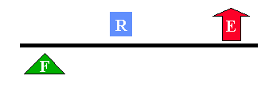
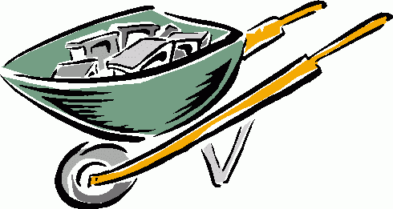
Second Class Lever
Second Class Lever
  The output (resistance) is in the middle
  always increases force
  Ex: wheelbarrow

Slide 29
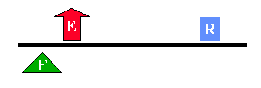

Third Class Lever
Third Class Levers
  Input (effort) force is in the middle
  always increases distance
  Ex: tweezers, bat, human body

Slide 30
Think FOIL
Fulcrum in middle = 1st class lever
Output in middle = 2nd class lever
Input in middle = 3rd class lever
LEVERS

Slide 31
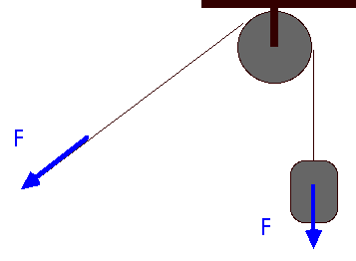
B. Pulley
Pulley
  grooved wheel with a rope or chain running along the groove
  a “flexible first-class lever”
F
L_{e}
L_{r}

Slide 32
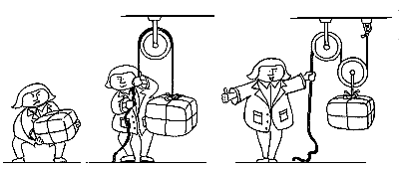
B. Pulley
Ideal Mechanical Advantage (IMA)
  equal to the number of rope segments if pulling up
  Equal to one less than the number of rope segments minus 1 if pulling down.
IMA = 0
IMA = 1
IMA = 2

Slide 33
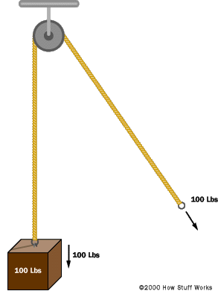
B. Pulley
Fixed Pulley
  IMA = 1
  does not increase force
  changes direction of force

Slide 34
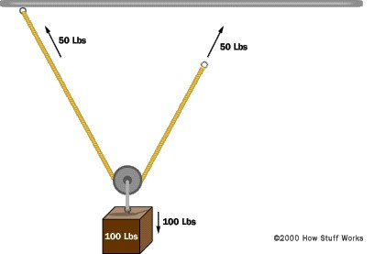
B. Pulley
Movable Pulley
  IMA = 2
  increases force
  doesn’t change direction

Slide 35
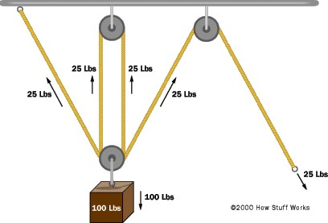
B. Pulley
Block & Tackle
  combination of fixed & movable pulleys
  increases force (IMA = 4)
  may or may not change direction

Slide 36
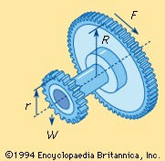
C. Wheel and Axle
Wheel and Axle
  two wheels of different sizes that rotate together
  a pair of
  “rotating
  levers”
Wheel
Axle

Slide 37
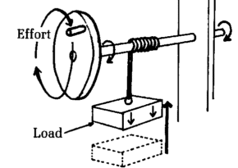
C. Wheel and Axle
Ideal Mechanical Advantage (IMA)
  effort force is applied to wheel
  axle moves less
  distance but with
  greater force
effort radius
resistance radius

Slide 38
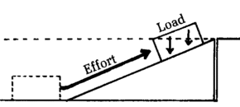
D. Inclined Plane
Inclined Plane
  sloping surface used to raise objects
h
l

Slide 39


E. Screw
Screw
  inclined plane wrapped in a spiral around a cylinder

Slide 40
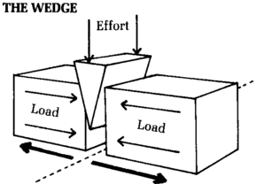
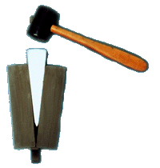
F. Wedge
Wedge
  a moving inclined plane with 1 or 2 sloping sides

Slide 41
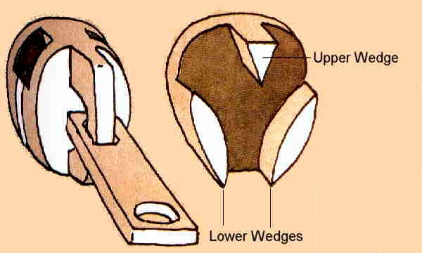
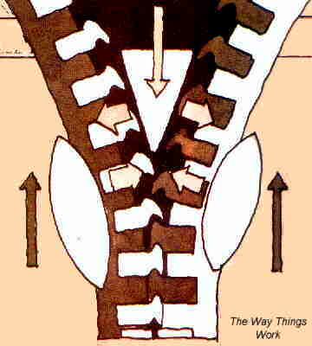
F. Wedge
Zipper
  2 lower wedges push teeth together
  1 upper wedge pushes teeth apart

Slide 42
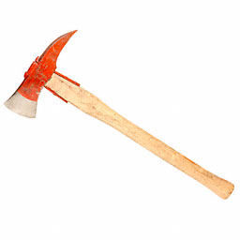
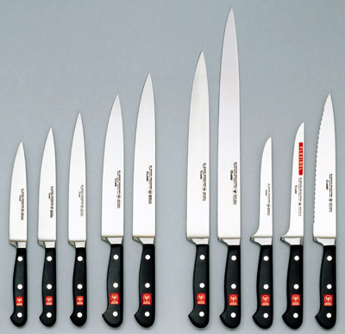
4. Wedges

Slide 43
How do machines make work easier?
1. Machines increase Force (total distance traveled is greater)
2. Machines increase distance (a greater force is required
3. Changes direction

Slide 44
Machines
IV. Using Machines
  Compound Machines
  Efficiency
  Mechanical Advantage

Slide 45
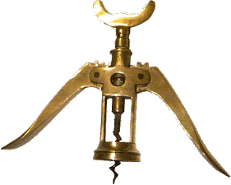
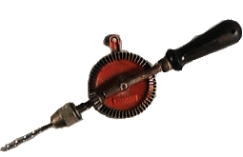
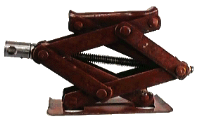
A. Compound Machines
Compound Machine
  combination of 2 or more simple machines

Slide 46
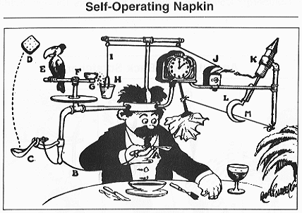
A. Compound Machines
Rube Goldberg Machine
A Rube Goldberg machine, contraption, invention, device, or apparatus is a deliberately over-engineered or overdone machine that performs a very simple task in a very complex fashion, usually including a chain reaction. The expression is named after American cartoonist and inventor Rube Goldberg

Slide 47
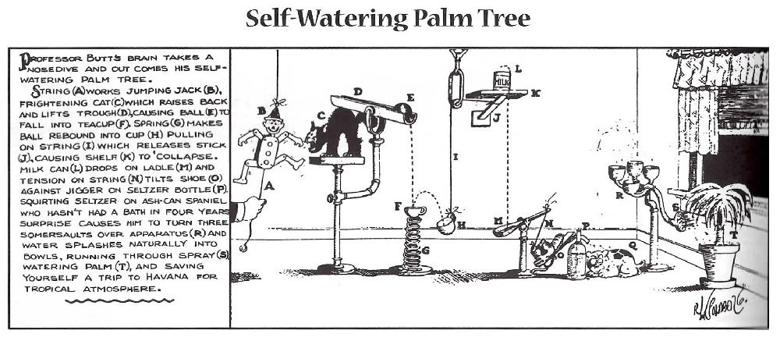

Slide 48
Work In
Effort force – F_{E} (Force in)
The force applied to the
machine (usually by you)
Work in – W_{in} (Force in x distance in)
The work done by you on the
machine

Slide 49
Work Out
Resistance force – F_{R} (Force out)
The force applied by the
machine to overcome resistance
Work out – W_{out}
(Force out x distance out)
The work done
by the machine

Slide 50
Mechanical Advantage
How much a machine multiplies force or distance
output force (F_{R})
MA = input force (F_{E})
Or
input distance
output distance

Slide 51
Mechanical advantage
The number of times a force exerted on a machine is multiplied by the machine
Mechanical advantage (MA). = resistance force
effort force
Mechanical advantage (MA) = effort distance resistance distance

Slide 52
Mechanical Advantage
What is the mechanical advantage of the following simple machine?
12 m
3 m
GIVEN:
d_{e} = 12 m
d_{r} = 3 m
MA = ?
WORK:
MA =d_{e} ÷ d_{r}
MA = (12 m) ÷ (3 m)
MA = 4
d_{e}
MA
d_{r}

Slide 53
Mechanical Advantage
Calculate the mechanical advantage of a ramp that is 6.0 m long and 1.5 m high.
GIVEN:
d_{e} = 6.0 m
d_{r} = 1.5 m
MA = ?
WORK:
MA =d_{e} ÷ d_{r}
MA = (6.0 m) ÷ (1.5 m)
MA = 4
d_{e}
MA
d_{r}

Slide 54
D. Mechanical Advantage
A worker applies an effort force of 20 N to open a window with a resistance force of 500 N. What is the crowbar’s MA?
GIVEN:
F_{e} = 20 N
F_{r} = 500 N
MA = ?
WORK:
MA = F_{r} ÷ F_{e}
MA = (500 N) ÷ (20 N)
MA = 25
F_{r}
MA
F_{e}

Slide 55
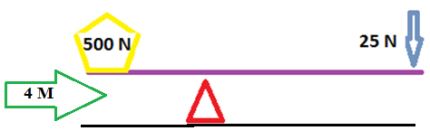
Mechanical Advantage
What is the mechanical advantage of the following simple machine?
How much work did the
machine do?
GIVEN:
F_{e} = 25 N
F_{r} = 500 N
MA = ?
WORK:
MA =F_{r} ÷ F_{e}
MA = (500N) ÷ (25N)
MA = 20
F_{r}
MA
F_{e}

Slide 56
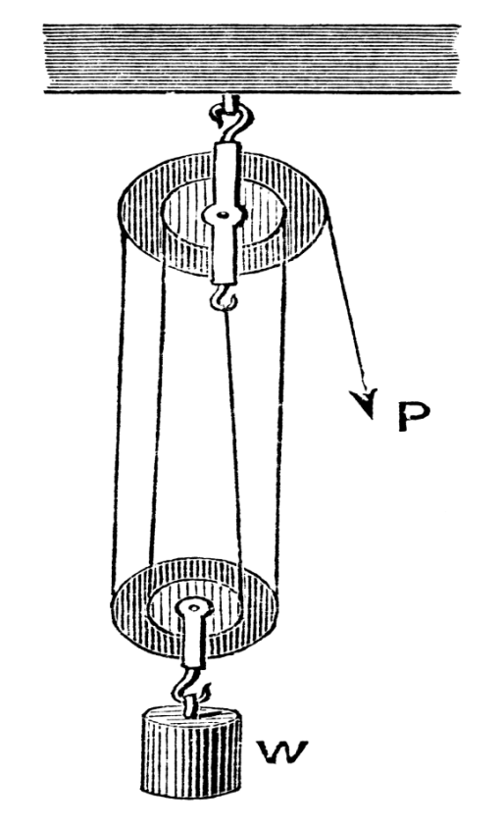
Short cut for finding M.A. of Pulleys
Mechanical Advantage of pulleys is very easy
  Count the number of rope segments visible
  If rope is pulling down subtract 1
  If rope is pulling up do nothing
  Example:
    5 rope segments
    Pulling down so subtract 1
    Mechanical Advantage = 5-1= 4

Slide 57

Pulley A
  2 rope segments
  Subtract 1 b/c pulling down
  MA = 2-1=1
Pulley B
  2 rope segments
  Pulling up do nothing
  MA=2
Pulley Pulley
A B

Slide 58
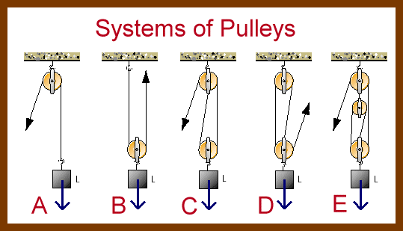
A: 2-1=1
B: 2
C: 3-1=2
D: 3
E: 4-1=3

Slide 59
Ideal machine
W_{in} = W_{out}
100% energy transfer.
There is no such thing as an ideal machine – you always lose some energy (through friction, air resistance, etc.)

Slide 60
efficiency =
(W_{out} / W_{in} ) x 100%
W_{in} is always
greater than W_{out}

Slide 61
Efficiency – a measure of how much of the work put into a machine is changed into useful output work by the machine. (less heat from friction)

Slide 62
B. Efficiency
Efficiency
  measure of how completely work input is converted to work output
  always less than 100% due to friction

Slide 63
Efficiency Practice Problems
If a machine requires 26.0 J of work input to operate and produces 22.0 J of work output, what is it’s efficiency?

